Slide 1
Administrative
RUTGERS UNIVERSITY Computer Sciences Department
CS 518 Operating Systems Theory
Sudarsun Kannan
HW-1 to be released this weekend
Multi-kernel paper review – Due Tuesday before the class
Start reading concurrency section
Disclaimer: Materials derived and modified from Prof. Timothy’s Lecture Notes

Slide 2
Administrative
RUTGERS UNIVERSITY Computer Sciences Department
CS 518 Operating Systems Theory
Sudarsun Kannan
HW-1 – Three Parts
IPC over shared memory – benchmarking (~7 days)
C/C++ program to find the L1, L2, L3, TLB size and memory latency (~12 days)
Adding a new system call in Linux (~11 days)
H/W 1 is not complex, helps you to learn the basics. Get started early!

Slide 3
Microkernel Intro History Design Performance Issues Fixing Performance Issues
RUTGERS UNIVERSITY Computer Sciences Department
CS 518 Operating Systems Theory
Sudarsun Kannan

Slide 4
Microkernels
Micro-kernels represent a well-studied OS structuring idea:
– very small kernel (implementing little more than address spaces and threads)
– most of the functionality outside the kernel – very fast communication between OS components (to compensate for distribution)
Notes:
Why resource management?
- resource are shared for efficiency
- fairness
- Scheduling, VM

Slide 5
Microkernels
Notes:
Why resource management?
- resource are shared for efficiency
- fairness
- Scheduling, VM

Slide 6
Microkernel
Kernel
Contains code which must run in privileged mode
Isolates hardware dependence from higher levels
Small and fast extensible system
Provides mechanisms
User‐level servers:
• Are hardware independent/portable
• Provide the “OS environment/personality”
• May be invoked: – From application (via message‐passing IPC) – From kernel (via upcalls)
• Implement policies
Notes:
Why resource management?
- resource are shared for efficiency
- fairness
- Scheduling, VM

Slide 7
What should be inside Microkernel?
What should the kernel implement?
implies limited functionality guaranteed,
also need for protection domain crossings
The answer should depend on functionality — not performance
many of the traditional performance bottlenecks can be eliminated
Also – can cross-protection domain interactions be efficiently supported
Notes:
Why resource management?
- resource are shared for efficiency
- fairness
- Scheduling, VM

Slide 8
Examples of microkernel flexibility
Device drivers won’t be in the kernel.
They are just servers that access I/O ports mapped to their address space
RPC on top of a basic IPC mechanism can be implemented as an external server
Unix system calls can be implemented as an external server
Everything but processor architecture, first-level TLB and cache
Notes:
Why resource management?
- resource are shared for efficiency
- fairness
- Scheduling, VM

Slide 9
Microkernel Intro History Design Performance Issues Fixing Performance Issues
RUTGERS UNIVERSITY Computer Sciences Department
CS 518 Operating Systems Theory
Sudarsun Kannan

Slide 10
Mach = μkernel?
Most OS services implemented at user level
Using memory objects and external pagers
Provides mechanisms, not policies
Mostly hardware independent
Big! – 140 system calls (300 in later versions), >100 kLOC
Unix 6th edition had 48 system calls, 10kLOC without drivers – 200 KiB text size (350 KiB in later versions)
Poor performance – Tendency to move features into kernel
Notes:
Why resource management?
- resource are shared for efficiency
- fairness
- Scheduling, VM

Slide 11
Critique of microkernel architectures
“Personally, I’m not interested in making device drivers look like user‐level. They aren’t, they shouldn’t be, and microkernels are just stupid.”
‐‐ Linus Torvalds
Notes:
Why resource management?
- resource are shared for efficiency
- fairness
- Scheduling, VM

Slide 12
Microkernel Failure Story – Workplace (~1990)
Notes:
Why resource management?
- resource are shared for efficiency
- fairness
- Scheduling, VM

Slide 13
Microkernel Used? – Yes!
Apple mobile application processors beginning with the A7 contain a Secure Enclave coprocessor running an L4 operating system based on the L4-embedded kernel developed at NICTA in 2006.
Notes:
Why resource management?
- resource are shared for efficiency
- fairness
- Scheduling, VM

Slide 14
Microkernel Intro History Design Performance Issues Fixing Performance Issues
RUTGERS UNIVERSITY Computer Sciences Department
CS 518 Operating Systems Theory
Sudarsun Kannan

Slide 15
Micro-kernel concepts
The kernel should implement?
“...a concept is tolerated inside the μ‐kernel only if moving it outside the kernel, i.e. permitting competing implementations, would prevent the implementation of the system’s required functionality.”
Notes:
Why resource management?
- resource are shared for efficiency
- fairness
- Scheduling, VM

Slide 16
Micro-kernel concepts
Objective: System must support interactive and not completely trustworthy applications
protection
principle of independence – S can make guarantees independent of S’
principle of integrity – S1 and S2 must be able to establish a channel that can be neither corrupted not eavesdropped by S’
Notes:
Why resource management?
- resource are shared for efficiency
- fairness
- Scheduling, VM

Slide 17
Micro-kernel concepts
The kernel should implement only three things:
address spaces
threads and IPC
unique identifiers
Notes:
Why resource management?
- resource are shared for efficiency
- fairness
- Scheduling, VM

Slide 18
Address spaces
Only a few concepts are fundamental
an initial address space that represents the physical memory
operations grant, map, and flush
unique identifiers
Grant:
the owner of address space A gives the page to another address space, B. The page is removed from A
the recipient has to agree
only used in special cases: when a server is an intermediary for others
Notes:
Why resource management?
- resource are shared for efficiency
- fairness
- Scheduling, VM

Slide 19
Address spaces
Map
like grant, but the owner of A shares the page with B
Flush
when the owner of A flushes a page, the page is removed from all address spaces that received it from A through a (direct or indirect) grant or map
I/O devices are supported by associating an address space
works for memory-mapped I/O and I/O ports
Notes:
Why resource management?
- resource are shared for efficiency
- fairness
- Scheduling, VM

Slide 20
Address spaces
Map
like grant, but the owner of A shares the page with B
Flush
when the owner of A flushes a page, the page is removed from all address spaces that received it from A through a (direct or indirect) grant or map
I/O devices are supported by associating an address space
works for memory-mapped I/O and I/O ports
Notes:
Why resource management?
- resource are shared for efficiency
- fairness
- Scheduling, VM

Slide 21
Microkernel Intro History Design Performance Issues Fixing Performance Issues
RUTGERS UNIVERSITY Computer Sciences Department
CS 518 Operating Systems Theory
Sudarsun Kannan

Slide 22
IPC in UNIX is usually heavyweight
IPC mechanisms in conventional systems tend to combine:
Notification: (telling the destination process that something has happened)
Scheduling: (changing the current runnable status of the destination, or source)
Data transfer: (actually conveying a message payload)
Unix doesn’t have a lightweight IPC mechanism
Notes:
Why resource management?
- resource are shared for efficiency
- fairness
- Scheduling, VM

Slide 23
Lots of Unix IPC mechanisms
Pipes
Signals
Unix‐domain sockets
POSIX semaphores
FIFOs (named pipes)
Shared memory segments
System V semaphore sets
POSIX message queues
System V message queues
etc.
Notes:
Why resource management?
- resource are shared for efficiency
- fairness
- Scheduling, VM

Slide 24
IPC Example
Notes:
Why resource management?
- resource are shared for efficiency
- fairness
- Scheduling, VM

Slide 25
IPC Example
Notes:
Why resource management?
- resource are shared for efficiency
- fairness
- Scheduling, VM

Slide 26
IPC in Unix is usually polled
Blocking read()/recv() or select()/poll()
Signals are the nearest thing to upcalls, but...
Scheduling: (changing the current runnable status of the destination, or source)
Unix lacks a good upcall / event delivery mechanism
Notes:
Why resource management?
- resource are shared for efficiency
- fairness
- Scheduling, VM

Slide 27
How to reduce IPC cost? (Part of HW 1)
Can you think about reducing system call cost and OS interaction for shared memory?
Write a program to implement communication across a parent and child process (fork) via. shared memory.
The parent and child process should write a 4KB page and read 4KB page
Compare the performance of shared memory implementation against blocking I/O-based IPC communication between parent and child process
Measure the cache misses, instructions executed, TLB misses for both IPC communication types using Linux Perf tool.
Notes:
Why resource management?
- resource are shared for efficiency
- fairness
- Scheduling, VM

Slide 28
Performance Analysis of Microkernel
Notes:
Why resource management?
- resource are shared for efficiency
- fairness
- Scheduling, VM

Slide 29
Interpretation
System call costs are high
Context switching costs are high
Getting worse with increasing CPU/memory speed ratios and lengthening pipelines
IPC (system call + context switch) expensive
Notes:
Why resource management?
- resource are shared for efficiency
- fairness
- Scheduling, VM

Slide 30
Experience with μkernel performance
Observations:
Mach memory penalty higher (i.e.,) cache misses or write stalls
Mach VM system executes more instructions than Ultrix
But portable and has more functionality
Claim: Degraded performance is result of OS structure IPC cost is not a major factor:
Notes:
Why resource management?
- resource are shared for efficiency
- fairness
- Scheduling, VM

Slide 31
Reducing System Call Cost – L3/L4
Minimise number of system calls
Combined operations: Call, ReplyWait
Complex messages
Combines multiple messages into one operation
As many arguments as possible in registers
via direct mapping, not user → kernel → user
Notes:
Why resource management?
- resource are shared for efficiency
- fairness
- Scheduling, VM

Slide 32
Reducing Scheduler Cost
Lazy scheduling – Don’t update scheduling queues until you need to schedule
Direct process switch to receiver
Short messages in registers
Reducing cache and TLB misses
Frequently‐used TCB data near the beginning (single‐byte displacement)
IPC code and kernel tables in a single page (to reduce TLB pressure and refills)
Notes:
Why resource management?
- resource are shared for efficiency
- fairness
- Scheduling, VM

Slide 33
Address space switches
If no flush is needed (tagged architectures or architectures with segment registers) the cost is smaller
Crucial idea: let’s keep small, commonly used server address spaces shared with regular “large” address spaces
Notes:
Why resource management?
- resource are shared for efficiency
- fairness
- Scheduling, VM

Slide 34
IPC and thread switches
this can be made fairly fast for most purposes.
Crucial idea: let’s keep small, commonly used server address spaces shared with regular “large” address spaces
system call, argument copy, stack and address space switch...
for L3 expensive – 100 cycle trap overhead
Notes:
Why resource management?
- resource are shared for efficiency
- fairness
- Scheduling, VM

Slide 35
Cross-domain call: the basics
A
B
A: syscall to post a message to B (e.g., a message queue). Wait for reply.
B: syscalls to receive an incoming message.
Wait for request.
Request: block A, wakeup B. Reply: block B, wakeup A.

Slide 36
Cross-domain call: the basics
Copy data from A to B, or use a shared memory region.
A
B
A: syscall to post a message to B (e.g., a message queue). Wait for reply.
B: syscalls to receive an incoming message.
Wait for request.
Transfer control through kernel: block A, wakeup B.
Note: could use a socket, or fast IPC for processes on same host.

Slide 37
“Marshalling” (“serializing”)
A
B
What if the data is a complex linked structure? Must “pack” it as a sequence of bytes into a message, and reconstitute it on the other side.

Slide 38
Concept: RPC (Used Every Google system)
Remote Procedure Call (RPC) is request/response interaction through a published API, using IPC messaging to cross an inter-process boundary.
API stubs
generated from an Interface Description Language (IDL)
Establishing an RPC connection to a named remote interface is often called binding.
RPC is used in many standard Internet services. It is also the basis for component frameworks like DCOM, CORBA, and Android. Software is packaged into named “objects” or components. Components may publish interfaces and/or invoke published interfaces of other components. Components may execute in different processes and/or on different nodes.

Slide 39
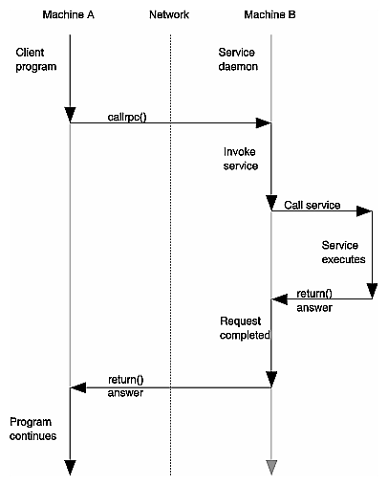
RPC Execution
In general, RPC enables request/response exchanges (e.g., by messaging over a network) that “looks like” a local procedure call.
In Android, RPC allows flexible interaction among apps running in different processes, across the kernel boundary.
How is this different from a local procedure call?
How is it different from a system call?

Slide 40
RCP Flow

Slide 41
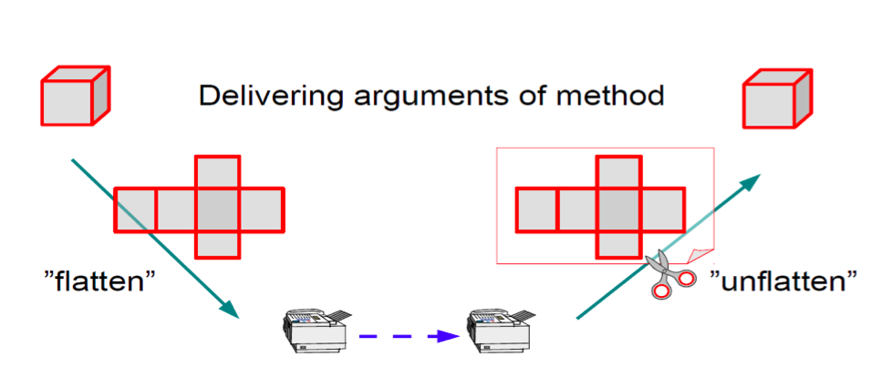
Marshalling: a metaphor
Android Architecture and Binder
Dhinakaran Pandiyan
Saketh Paranjape

Slide 42
RCP Flow
1. The client process calls the client stub, which resides within the client's address space.
2. The client stub packs the parameters into a message. This is called marshaling. The client stub then executes a system call (e.g., sendto) to send the message.
3. The kernel sends the message to the remote server machine.
4. The server stub receives the message from the kernel.
5. The server stub unmarshals the parameters.
6. The server stub calls the desired procedure.
7. The server process executes the procedure and returns the result to the server stub.
8. The server stub marshals the results into a message and passes the message to the kernel.
9. The kernel sends the message to the client machine.
10. The client stub receives the message from the kernel.
11. The client stub unmarshals the results and passes them to the caller

Slide 43
Stubs
RPC stubs are procedures linked into the client and server.
RPC stubs similar to system call stubs, but they do more than just trap to the kernel.
The RPC stubs construct/deconstruct a message transmitted through a messaging system.
Binder is an example of such a messaging system, implemented as a Linux kernel plug-in module (a driver) and some user-space libraries.
Stubs are generated by a tool that takes a description of the application’s RPC API written in an Interface Description Language.
Looks like any interface definition…
List of method names and argument/result types and signatures.
Stub code marshals arguments into request message, marshals results into a reply message.

Slide 44
LRPC
Simple control transfer: client’s thread executes in server’s domain
Simple data transfer: shared argument stack, plus registers
Simple stubs: i.e. highly optimized marshalling
Design for concurrency: Avoids shared data structures
Notes:
Why resource management?
- resource are shared for efficiency
- fairness
- Scheduling, VM

Slide 45
Switching Overhead
Kernel-user switch (measurements on a 50MHz x86 machine)
They are just servers that access I/O ports mapped to their address space
cost of machine instructions for entering supervisor mode and back: 71 + 36 cycles
Measured cost to enter the Mach kernel (like Linux) on this machine is 900 cycles!
Notes:
Why resource management?
- resource are shared for efficiency
- fairness
- Scheduling, VM

